Slide 1
Algorithms And Design
Arabic Programming Techniques

Slide 2
#003 Asymptotic notations and Basic efficiency classes
Arabic Programming Techniques

Slide 3
Bounds (Asymptotic Notations)
Bounds describe the limiting behavior of algorithm complexity at large (n). They are:
Worst Case: Upper Bound (Big O complexity)
Best Case: Lower Bound (Big Ω complexity)
Exact (Big Θ complexity)

Slide 4
Bounds (Asymptotic Notations)
f(n) ≤ c × g(n)
for all n ≥ n₀
c2×g(n) ≤ f(n) ≤ c1×g(n)
for all n ≥ n₀
f(n) ≥ c × g(n)
for all n ≥ n₀
c × g(n)
c₁ × g(n)
f(n)
f(n)
f(n)
c × g(n)
c₂ × g(n)
n₀
n
n₀
n
n₀
n
f(n) є Θ(g(n))
f(n) є Ω(g(n))
f(n) є O(g(n))

Slide 5
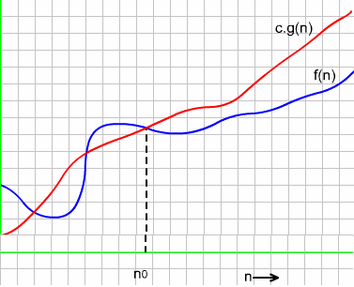
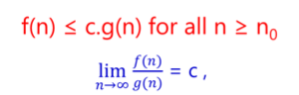
O-Notation: Definition

Slide 6
O-Notation : Examples
Example : Using basic definition, we show that
3n² + 10n ϵ O(n²)
Consider , 10 ≤ n for n ≥ 10 ( obvious !)
10n ≤ n² for n ≥ 10 ( Multiplying both sides with n )
3n²+10n ≤ 3n² + n² for n ≥ 10 ( Adding 3n² to both sides )
=4n² (Simplifying )
3n² + 10 n ≤ c.n² for n ≥ n₀ where c =4 and n₀= 10 (Solution)
Therefore, it follows from the basic definition that
3n² +10n = O(n²)

Slide 7
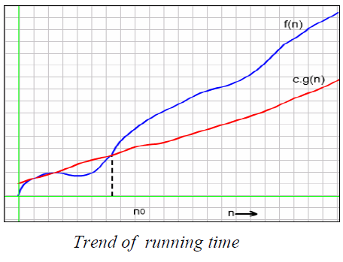
Ω-Notation Asymptotic Lower Bound

Slide 8
Example: We show that ½ n (n-1) ϵ θ(n²).
We need to prove that
c₂ g(n) ≤ F(n) ≤ c₁ g(n) for all n ≥ n_{o}
first, consider the upper bound,
F(n) ≤ c₁ g(n)
½ n(n-1) = ½ n² – ½ n ≤ ½ n² for all n ≥ 0.
Second, consider the lower bound,
c₂ g(n) ≤ F(n)
½ n(n-1) = ½ n² – ½ n ≥ ½ n² – ½ n ½ n for all n ≥ 2.
= ¼ n².
Hence we can select c₂ = ¼ , c₁= ½ , and n₀ = 2.

Slide 9
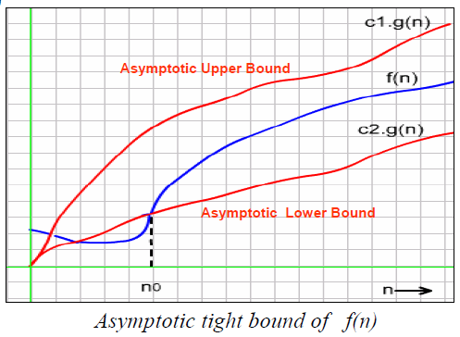
θ-Notation Definition

Slide 10
Materials
Look at the description
Code and slides will be in my github repo
Dot forget to join the face-book group

Slide 11
Thank you

